Slide 1


Copyright © 2020 [Rene & Teddy]

Slide 2
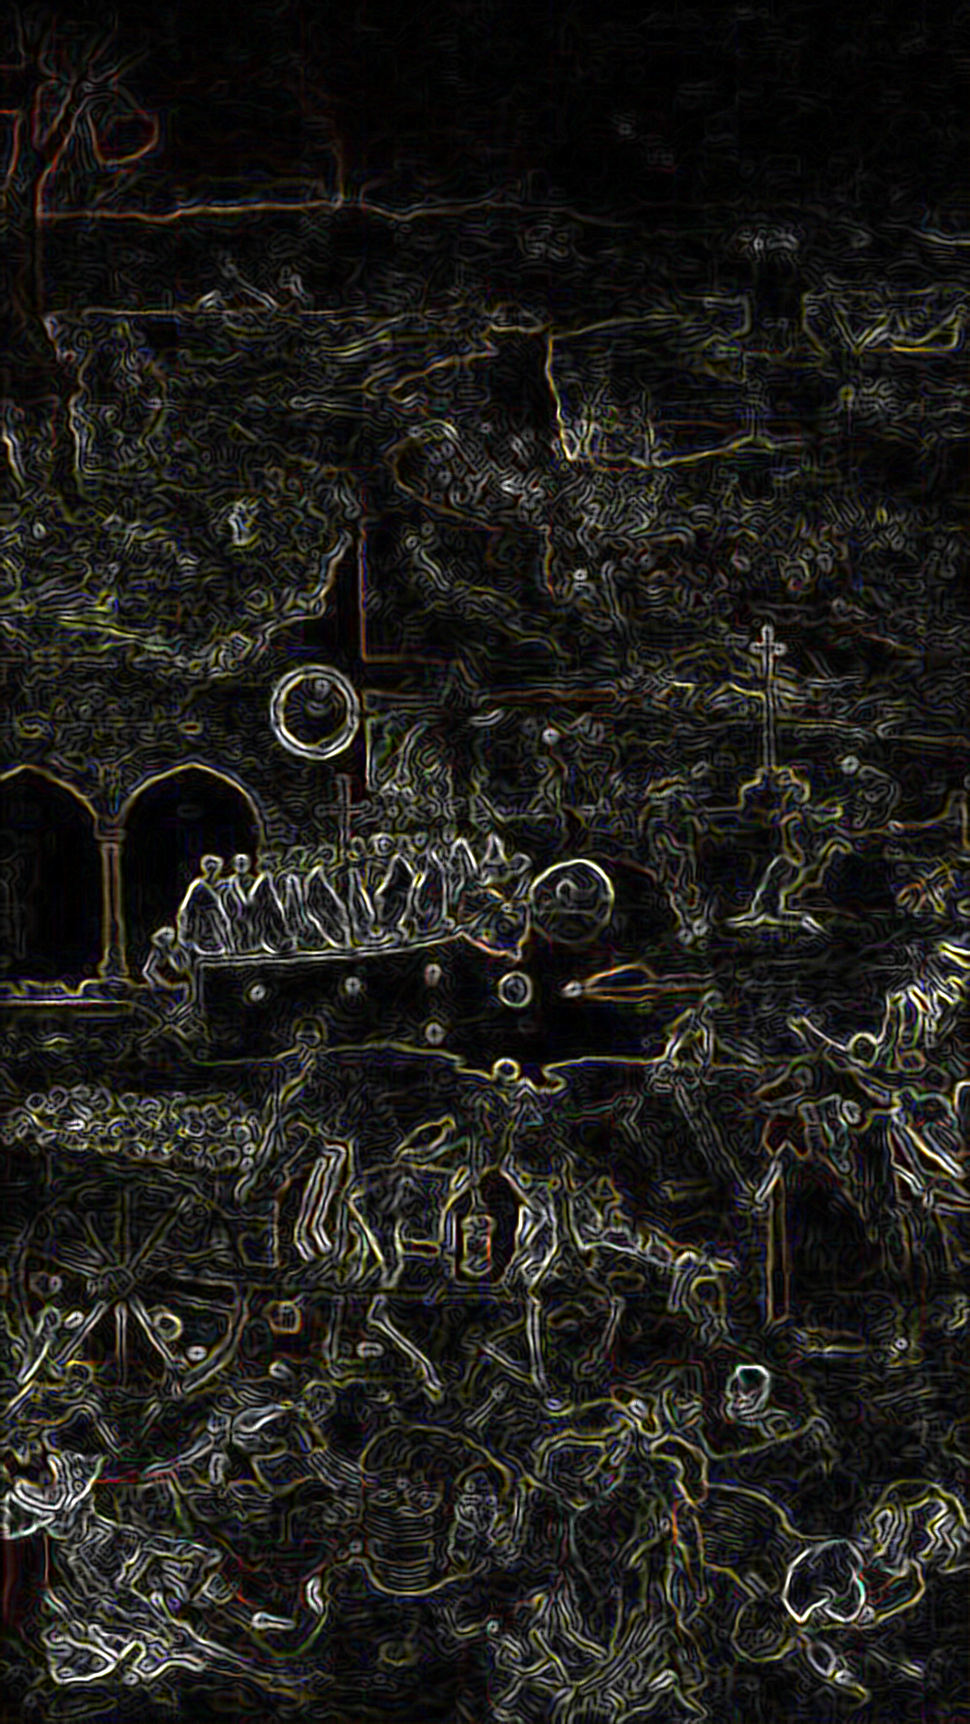
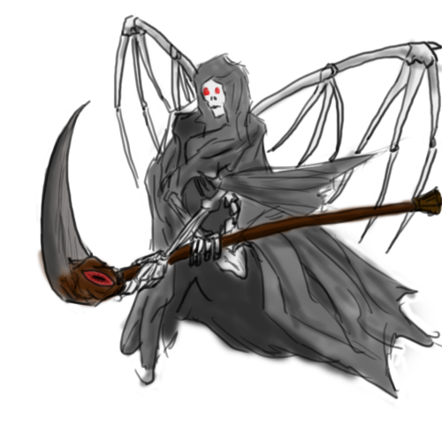
01 CONTENTS
CONTENTS
CONTENTS
CONTENTS

Slide 3
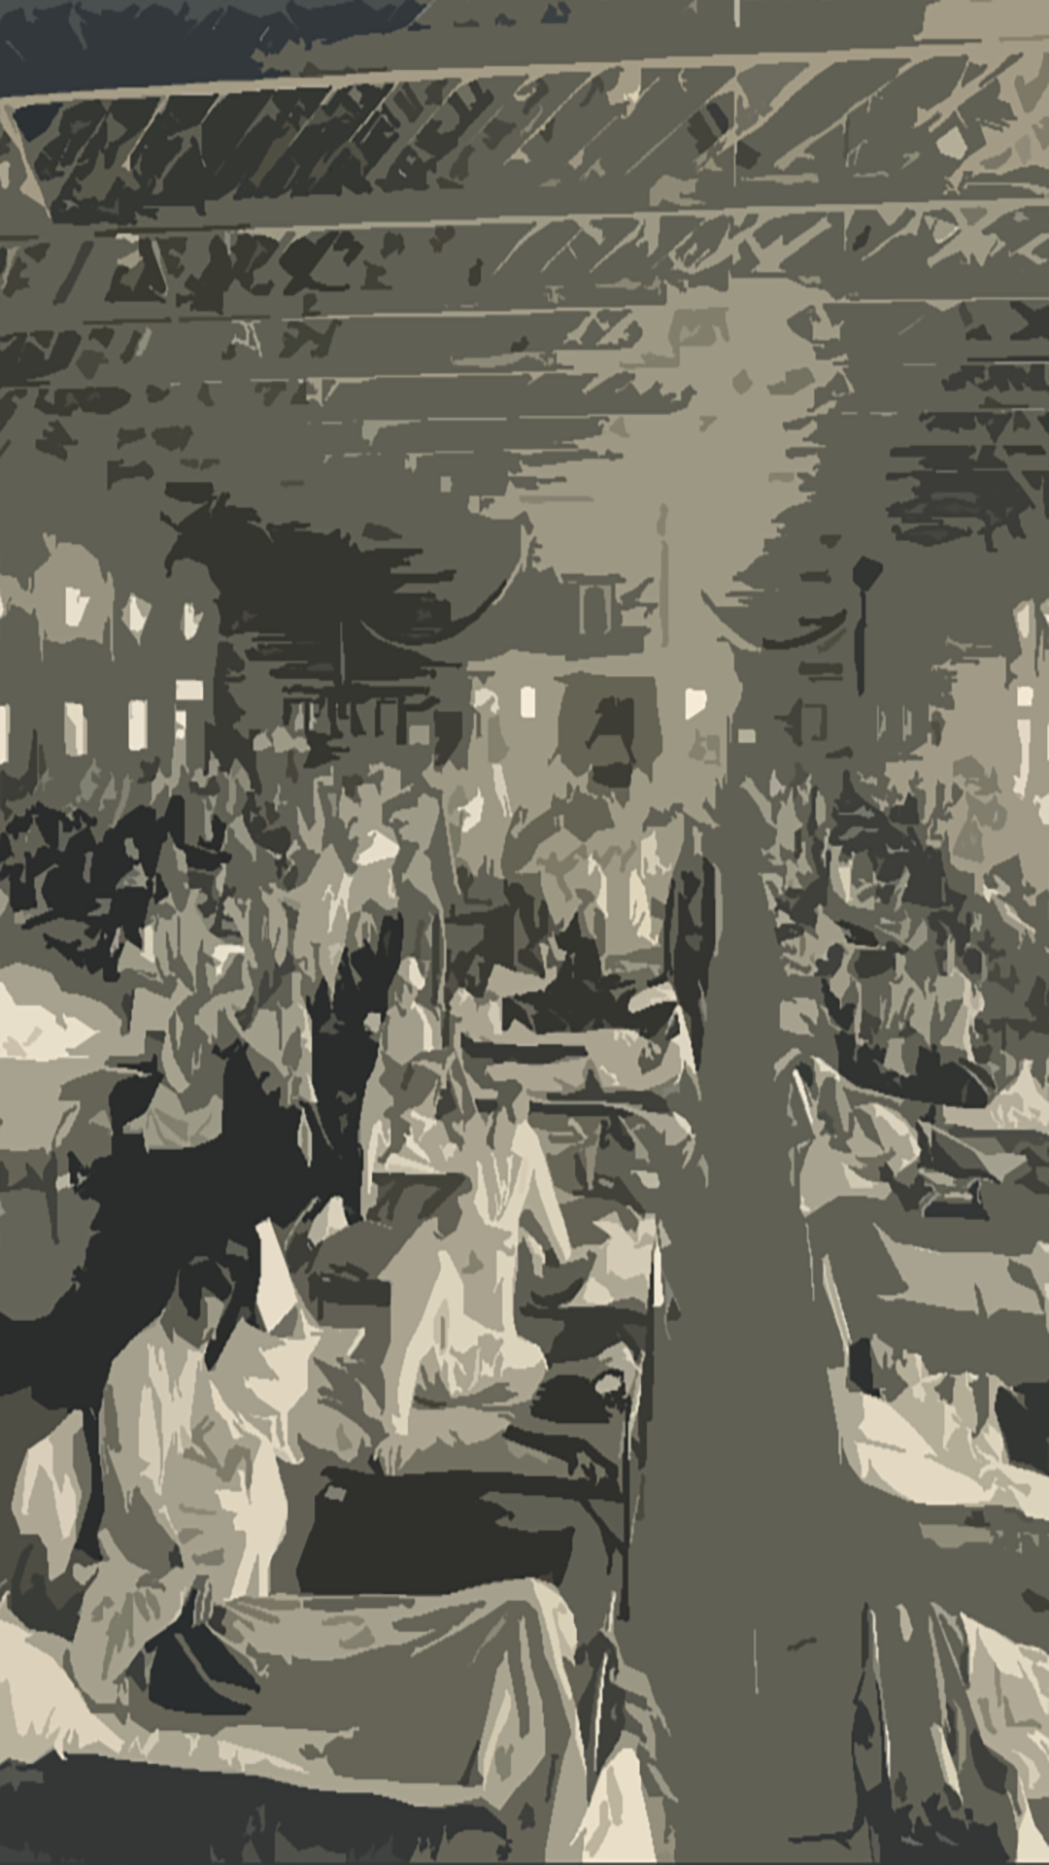
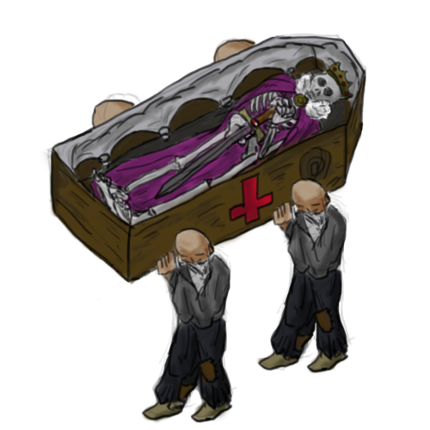
02 CONTENTS
CONTENTS
CONTENTS
CONTENTS

Slide 4


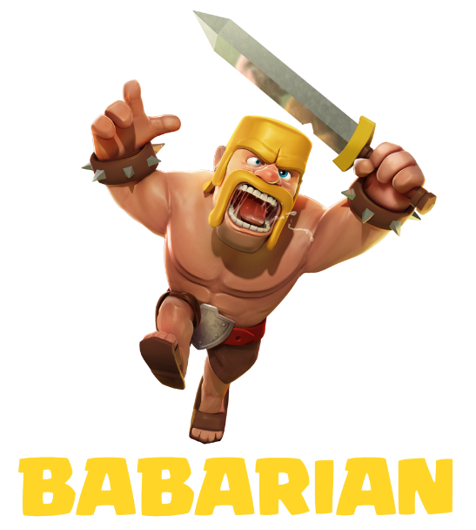
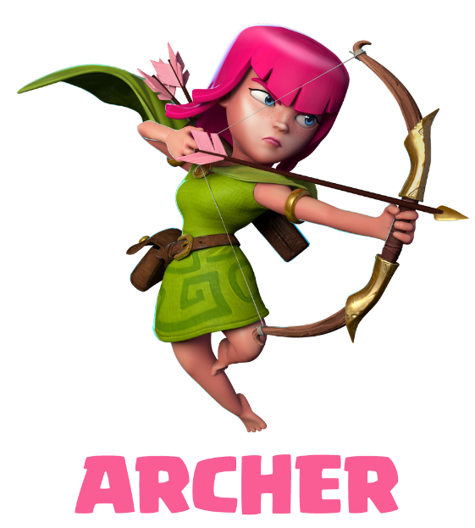
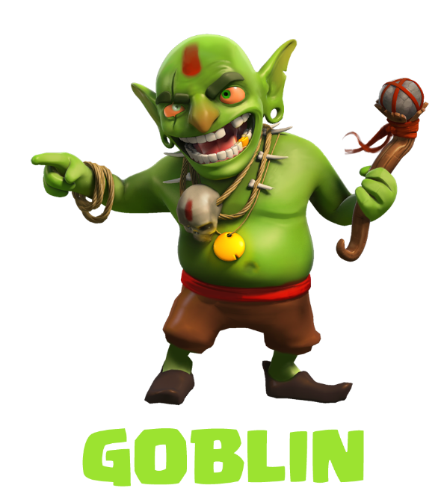
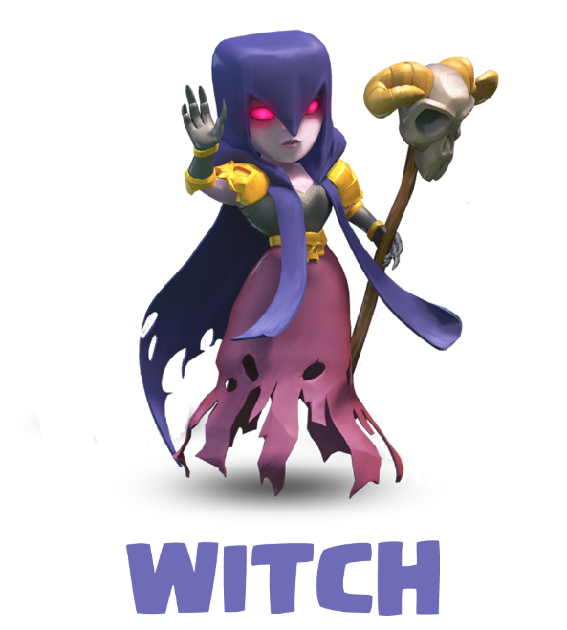
01 CONTENTS
02 CONTENTS
03 CONTENTS
01 CONTENTS
A SUBTITLE ABOUT TH TEAM
BABARIAN
ARCHER
GOBILIN
WITCH
멈출 수 없는 공격 본능.바바리안!!
도도한 명사수. 아처!!
약탈의 명수, 고블린!!
파괴의 여신, 마녀
Twelve kinds of media represented at the show last month. It included the work of fabric
Twelve kinds of media represented at the show last month. It included the work of fabric
Twelve kinds of media represented at the show last month. It included the work of fabric
Twelve kinds of media represented at the show last month. It included the work of fabric
Twelve kinds of media represented at the show last month. It included the work of fabric

Slide 5
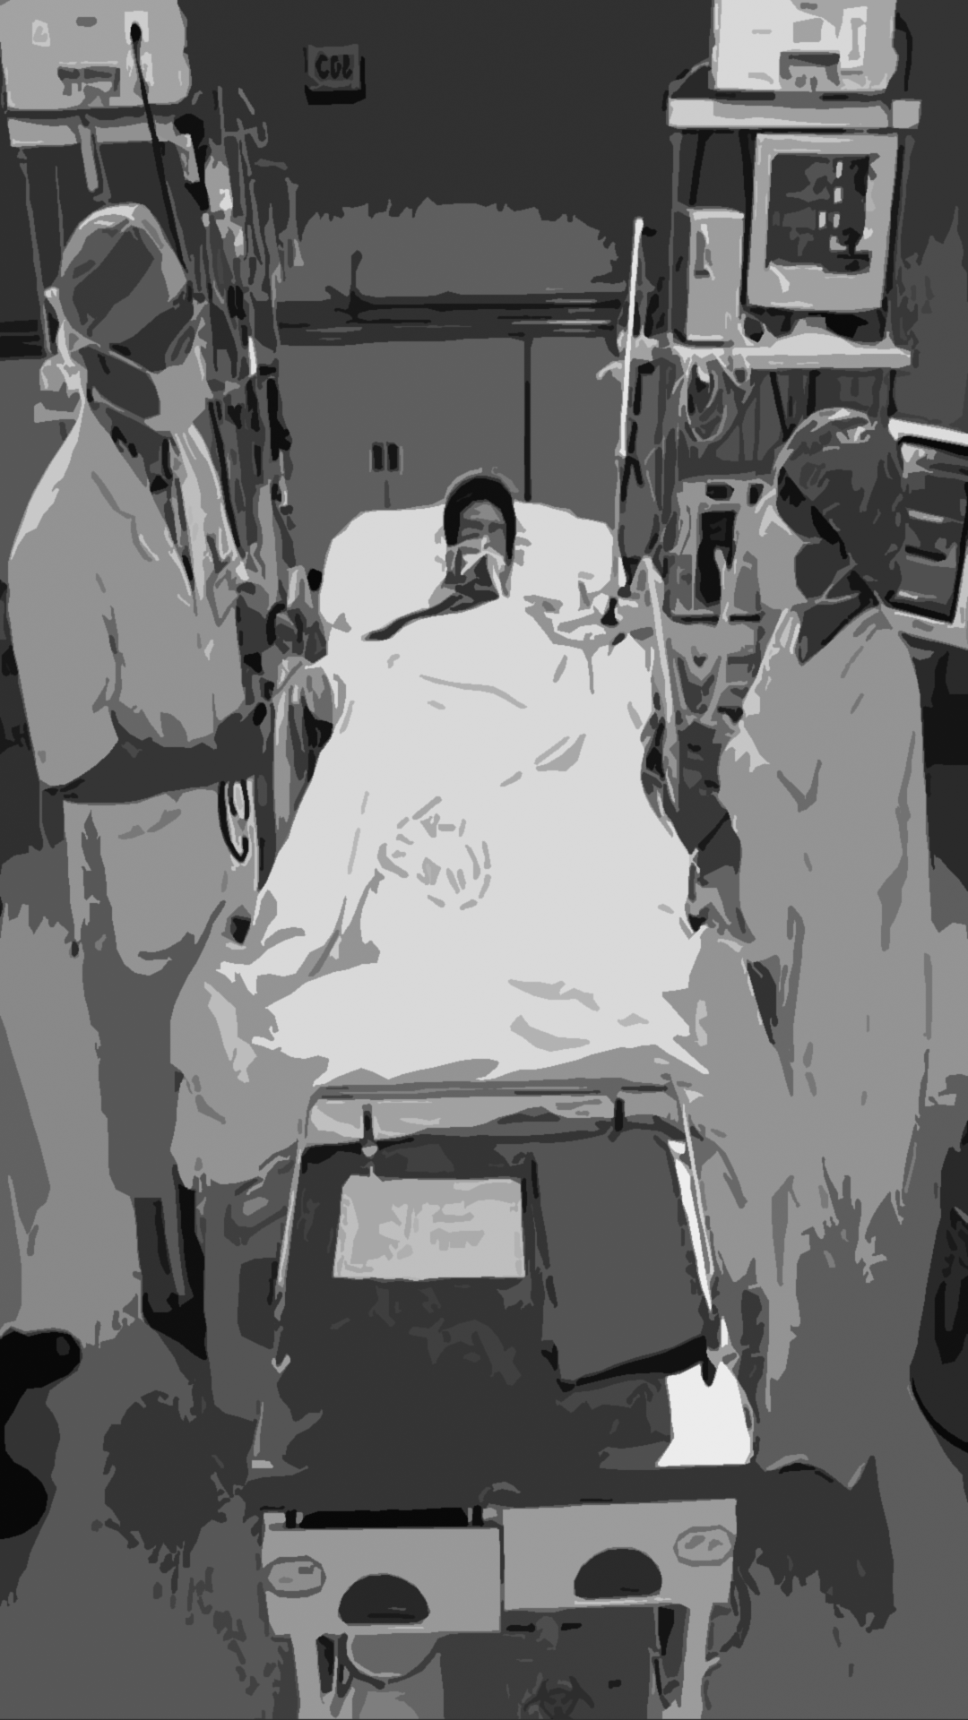
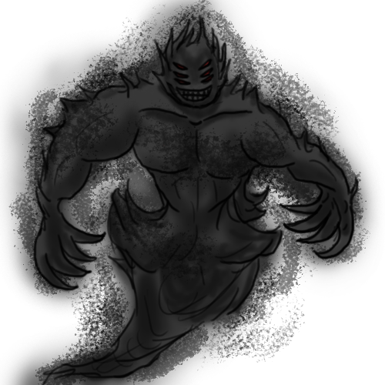
03 CONTENTS
CONTENTS
CONTENTS
CONTENTS

Slide 6
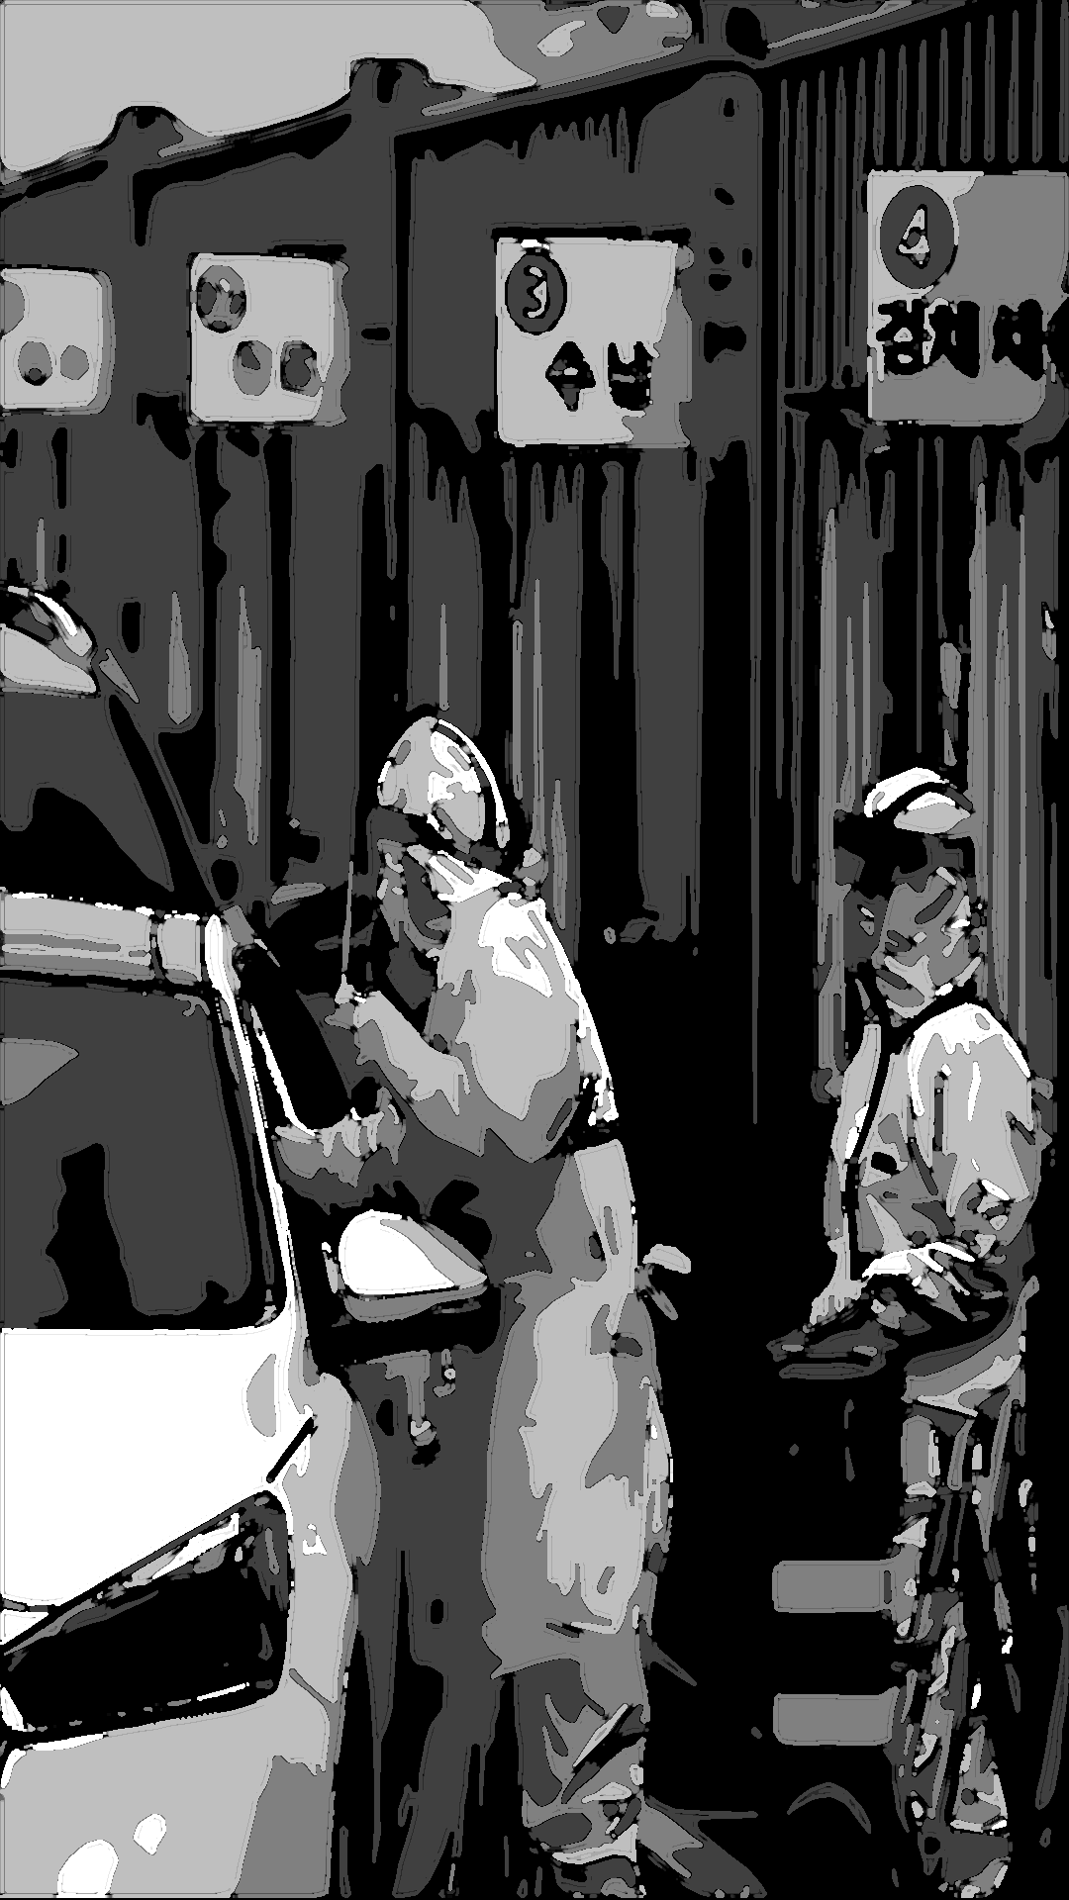
04 CONTENTS
CONTENTS
CONTENTS
CONTENTS

Slide 7
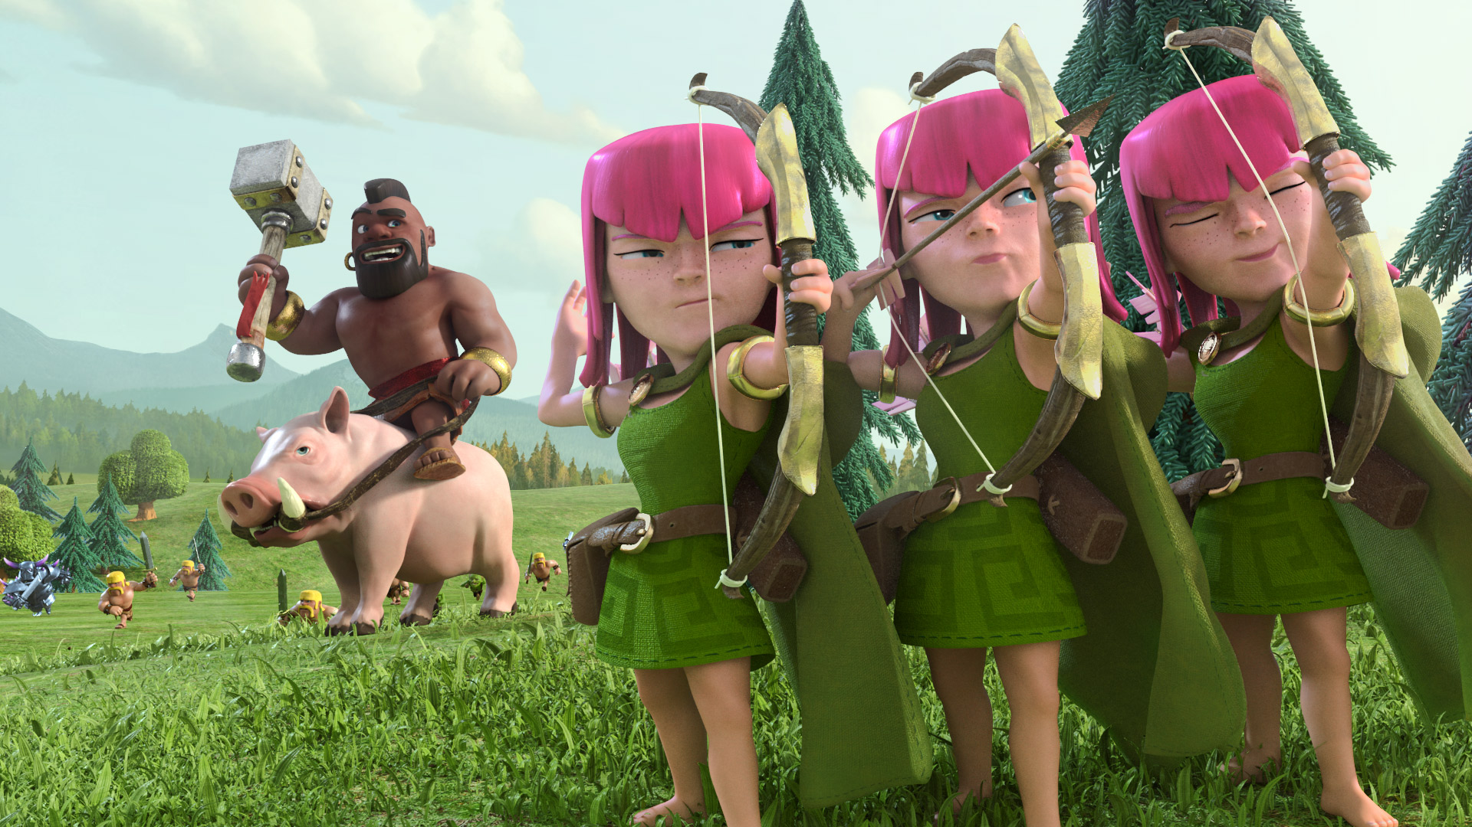
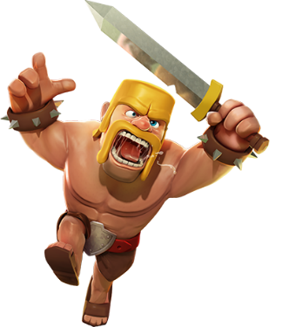
01 CONTENTS
CONTENTS
CONTENTS
CONTENTS
02 CONTENTS
CONTENTS
CONTENTS
CONTENTS
03 CONTENTS
CONTENTS
CONTENTS
CONTENTS

Slide 8


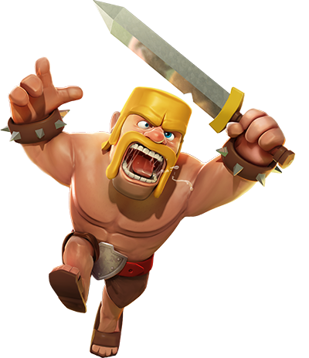
03 CONTENTS
CONTENTS
CONTENTS

Slide 9
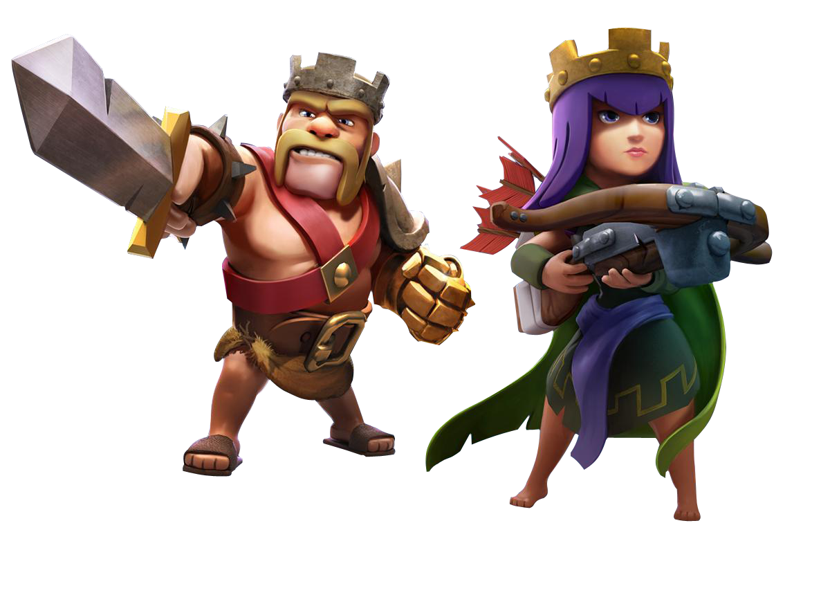
01 CONTENTS
CONTENTS
CONTENTS
CONTENTS
02 CONTENTS
CONTENTS
CONTENTS
CONTENTS
03 CONTENTS
CONTENTS
CONTENTS
CONTENTS

Slide 10
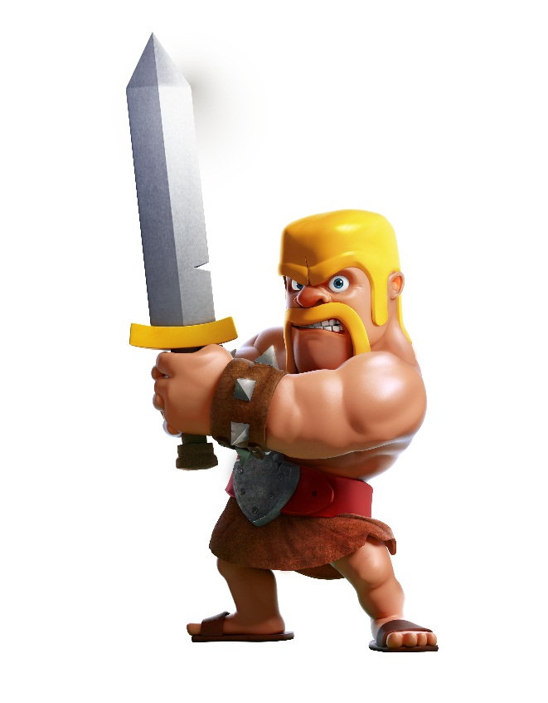
01 CONTENTS
CONTENTS
CONTENTS
CONTENTS

Slide 11


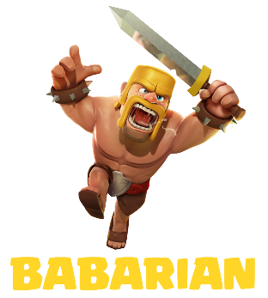


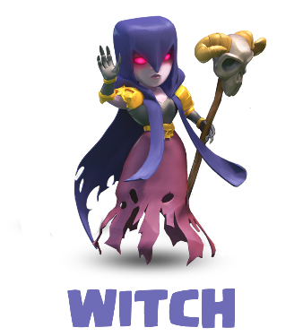
01 CONTENTS
02 CONTENTS
03 CONTENTS
02 CONTENTS
A SUBTITLE ABOUT TH TEAM
67%
67%
67%
67%
BABARIAN
ARCHER
GOBILIN
WITCH
Twelve kinds of media represented at the show last month. It included the work of fabric
Twelve kinds of media represented at the show last month. It included the work of fabric
Twelve kinds of media represented at the show last month. It included the work of fabric
Twelve kinds of media represented at the show last month. It included the work of fabric

Slide 12
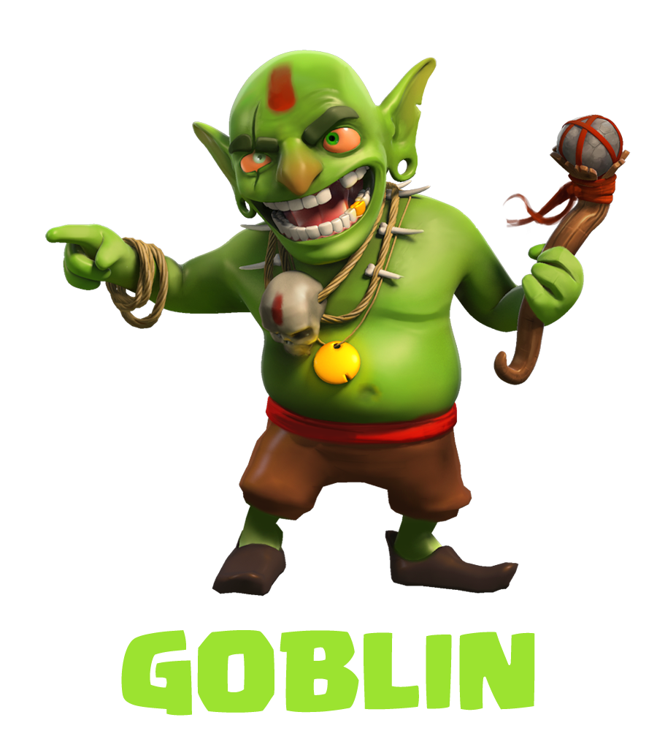



01 CONTENTS
02 CONTENTS
03 CONTENTS
03 CONTENTS
A SUBTITLE ABOUT TH TEAM
Twelve kinds of media represented at the show last month. It included the work of fabric
Twelve kinds of media represented at the show last month. It included the work of fabric
Twelve kinds of media represented at the show last month. It included the work of fabric
Twelve kinds of media represented at the show last month. It included the work of fabric

